Slide 1

Basic Details of the Team and Problem Statement
Ministry/Organization Name/Student Innovation: All India Council for Technical Education (AICTE)
PS Code: DR711
Problem Statement Title: Lack of information about Academic Activities in single platform
Team Name: Paradox
Team Leader Name: Vishal Gupta
Institute Code (AISHE): U-0643
Institute Name: Galgotias University
Theme Name: Smart Education

Slide 2
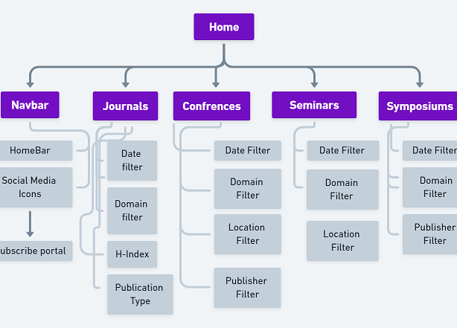
Idea/Approach Details
Describe your idea/Solution/Prototype here:
A multilingual web portal to be build for students, faculties and researchers to participate in global, national and local workshops, seminars, symposia, conferences, etc.
We will scrape the data of conferences, journals, workshops, seminars etc. from a bunch of third party sites solely made for this purpose only and will render all the data along with the required filters in our site.
Our portal’s basic architecture will comprise of 4 tiles for each purpose, a nav bar, a search bar (filtering with keywords), icons, a Forum section so that researchers and students can interact with each other, a Dashboard for students and researchers for uploading their CV, updating their bio, linking their LinkedIn and Github accounts, a section for Hackathons will also be there which help students to know about all the hackathons going on in the country so that they can participate and prepare in advance.
Filters will be applied(by using filtering algorithms) to filter the information scraped from third party sites about any conference, seminar, workshop, academic activities across the country, universities and international arena in chronological order and in subject areas according to their place, date, event type and name so that students and researchers can prepare well in advance and participate effectively and successfully.
Describe your Technology stack here:
Frontend: HTML5, React JS, Tailwind CSS, JavaScript
Backend: Node JS, Express JS, Web Scraping using Python, JQuery
Database: MongoDB
Deployment: Heroku pages/ Github pages

Slide 3
Idea/Approach Details
Describe your Use Cases here
Describe your Dependencies / Show stopper here
A newbie user will register/signup as a student or a researcher in the portal and will make their profile.
If a user has to find any conference, seminar, workshop, hackathon, journal by its date, place, submission date, publication type, topics of interest, journal ranking, impact score, h-index, publisher, overall ranking thus making all the information available to the user on a single platform under different sections
One Forum section can also be created for researcher, students to post their thoughts, discuss on a specific topics and can interact with each other and later on job and internship alerts section can also be created where students can apply according to their areas of interests.
Advertise with our portal – Promote events, Promote Conferences, Workshops, Symposiums, Seminars, etc. Promote Call for papers. Promote or advertise your Journal. Promote your website, blog, articles etc.
We have only “data dependency” from third party sites of dedicated platforms already available and working on the net.
Our data will be scraped from only legit and authentic sites plus it will be updated as many times a user accesses it.

Slide 4
Team Member Details
Team Leader Name: Vishal Gupta
Branch (Btech/Mtech/PhD etc): Btech Stream (ECE, CSE etc): CSE Year (I,II,III,IV): II
Team Member 1 Name: Arushi Rajdev
Branch (Btech/Mtech/PhD etc): Btech Stream (ECE, CSE etc): CSE Year (I,II,III,IV): II
Team Member 2 Name: Shrey Tyagi
Branch (Btech/Mtech/PhD etc): Btech Stream (ECE, CSE etc): CSE Year (I,II,III,IV): II
Team Member 3 Name: Abhinav Shukla
Branch (Btech/Mtech/PhD etc): Btech Stream (ECE, CSE etc): CSE Year (I,II,III,IV): II
Team Member 4 Name: Nitin Kumar
Branch (Btech/Mtech/PhD etc): Btech Stream (ECE, CSE etc): CSE Year (I,II,III,IV): II
Team Member 5 Name: Nischay Goyal
Branch (Btech/Mtech/PhD etc): Btech Stream (ECE, CSE etc): CSE Year (I,II,III,IV): II
Team Mentor 1 Name: Deependra Rastogi
Category (Academic/Industry): Academic Expertise (AI/ML/Blockchain etc): App Dev Domain Experience (in years):7
Team Mentor 2 Name: Divyansh Agarwal
Category (Academic/Industry): Industry Expertise (AI/ML/Blockchain etc): AI/ML Domain Experience (in years): 1

